Slide 1
SPRS 201 Training - DoD Only

Slide 2

Agenda
01
Risk Analysis
02
Supplier Risk Report
03
Item Risk Report
04
Market Research Report
05
Supplier Surveillance

Slide 3
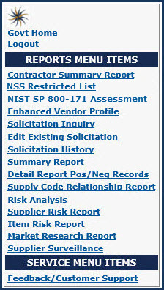
All reports are accessible from the
Reports Menu Items on the left side of the
Gov’t Home page

Slide 4
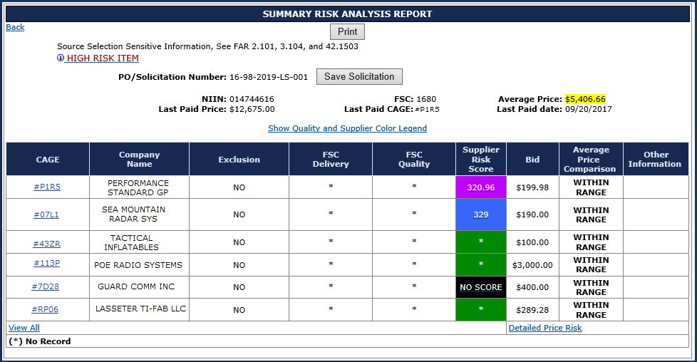
Risk Analysis Report Detail
Summary Risk
Analysis Report
Header displays:
An overview of
the solicitation
An alert, if the NSN
is considered a
High Risk Item
Confidence Level of Average Price
Green = High
Yellow = Medium
Red = Low
Average Price

Slide 5
Risk Analysis Report Detail 2
Summary Risk Analysis Report Body:
The first 3 columns contain Vendor information

Slide 6
Risk Analysis Report Detail 3
The next 3 columns contain the vendor’s scores
The offerors’ SPRS scores, combined into an overall Supplier Score

Slide 7
Risk Analysis Report Detail 4
The last 3 columns contain the entered bid amount & where it falls in comparison to the Average Price
The bids’ value related to the “predicted range”
The predicted
range is
± two
standard
deviations
from the
Average
Price
Bids are
Within
Range,
High or Low

Slide 8
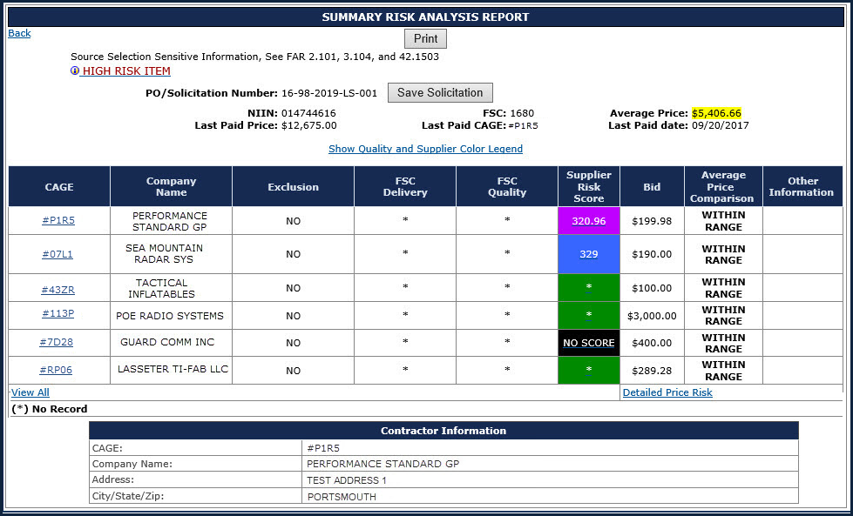
Risk Analysis Report Detail 6
Click any linked CAGE Code to view Vendor information

Slide 9
Risk Analysis Report Detail 7
Supplier Risk Scores:
Same SR 5-color scheme
Number = actual score
* = no scorable data, but vendor has contracts in EDA/WAWF
NO SCORE = vendor has no PPI
Supplier Risk Score
Each Score is a link to
Detailed Supplier Risk Report
Click “View All” to display
Summary Report for entered
CAGEs and FSC
Click “Detailed Price Risk” to display
Quote & Purchase History
(Next slides)

Slide 10
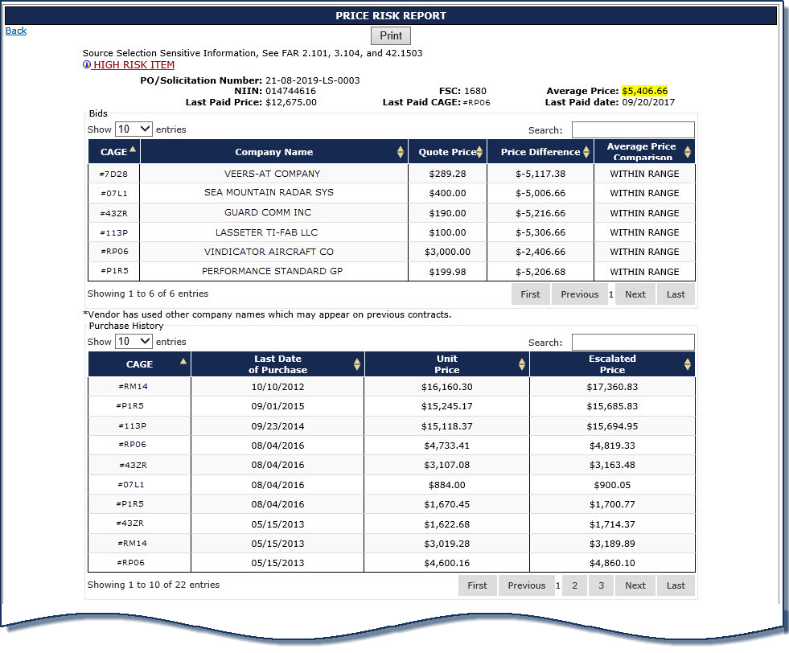
Detailed Risk Analysis Report (Top)
  Difference between bid and
  Average Price
  Historical prices escalated
  for inflation
  Click Next or Page # to
  view all Purchase History

Slide 11
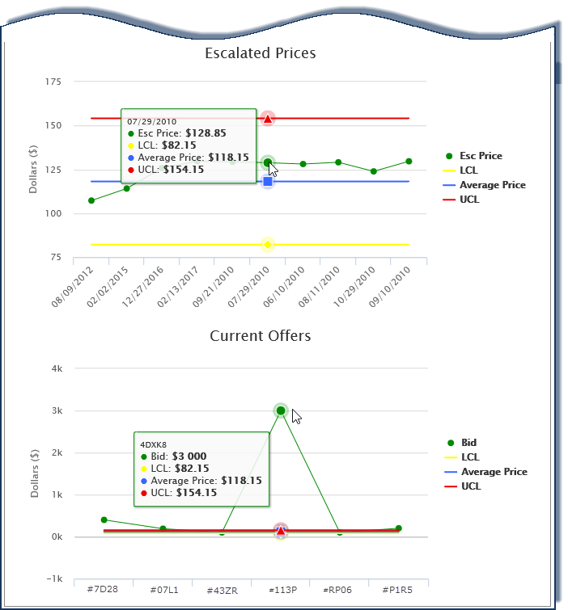
Detailed Risk Analysis Report (Bottom)
  Historical Prices
  (with inflation) plotted
  over predicted range
  Bids plotted over
  predicted range
  Expected Range Control Limits
LCL – Lower Control Limit
Average Price
UCL – Upper Control Limit
- Bid

Slide 12
Risk Analysis – High Risk Alert
If the HIGH RISK ITEM alert is displayed in the Header click to display the Agency-supplied risk detail

Slide 13
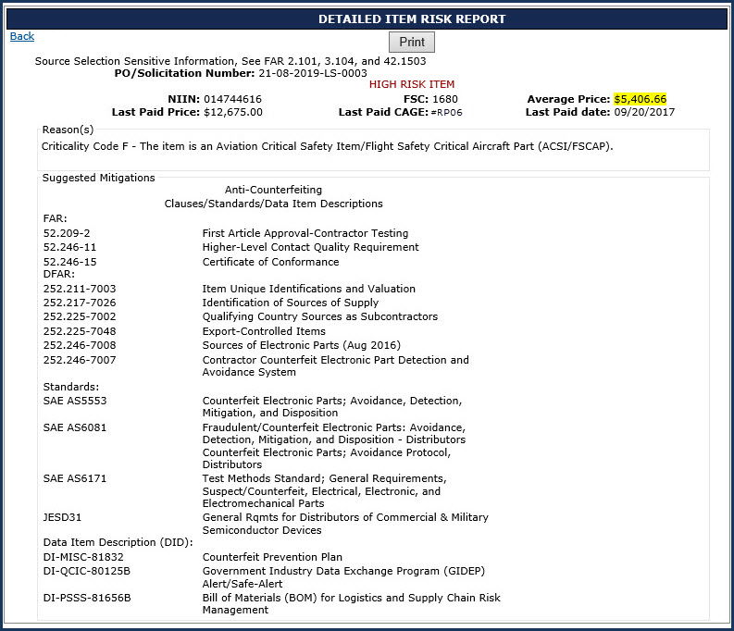
Risk Analysis
High Risk Alert 2
  Agency-supplied risk detail
  Provides one or more reasons for
  the item to be considered High Risk
  Shows suggested mitigation
  strategies based on agency policies

Slide 14
Risk Analysis Report Detail 27
Supplier Risk Scores:
Same SR 5-color scheme
Number = actual score
* = no scorable data, but vendor has contracts in EDA/WAWF
NO SCORE = vendor has no PPI
Supplier Risk Score
Each Score is a link to
Detailed Supplier Risk Report

Slide 15
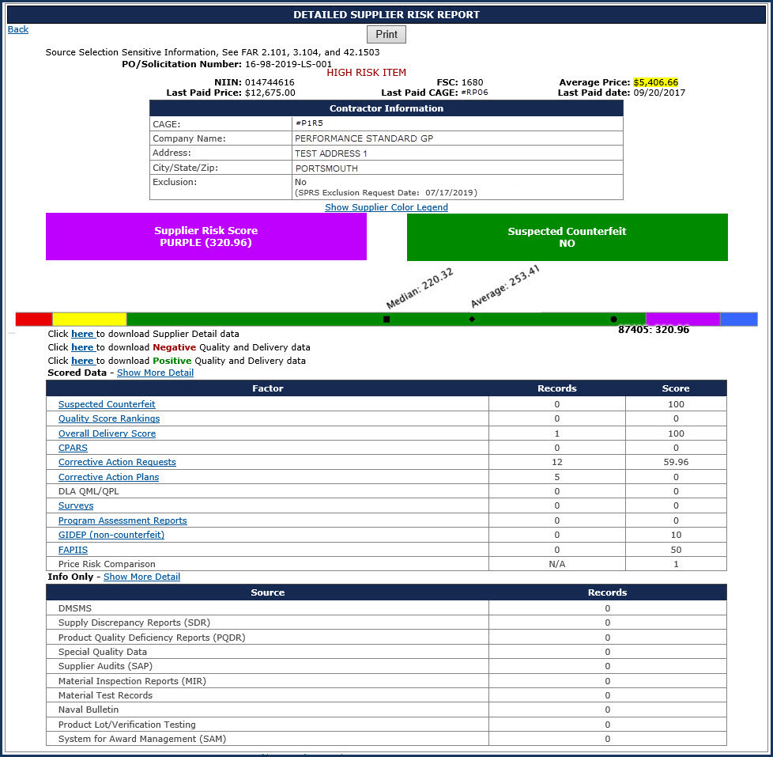
Risk Analysis
Supplier Risk Score
  Click any linked Supplier Risk Score on
  the Summary Risk Analysis Report to
  display the Detailed Supplier Risk Report
  Scored Data are Factors that go into the
  numerical score
  If records are > 0, the Factor becomes a link to
  display additional detail
  Info Only is data of interest but not scored
  Detail is available if records are > 0
  *NOTE: The Supplier Score shown when
  performing a procurement Risk Analysis also
  considers if the vendor is on DLA’s Qualified
  Manufacturer/Producer List, so it may be
  different than the one displayed in the
  standalone Supplier Risk report

Slide 16
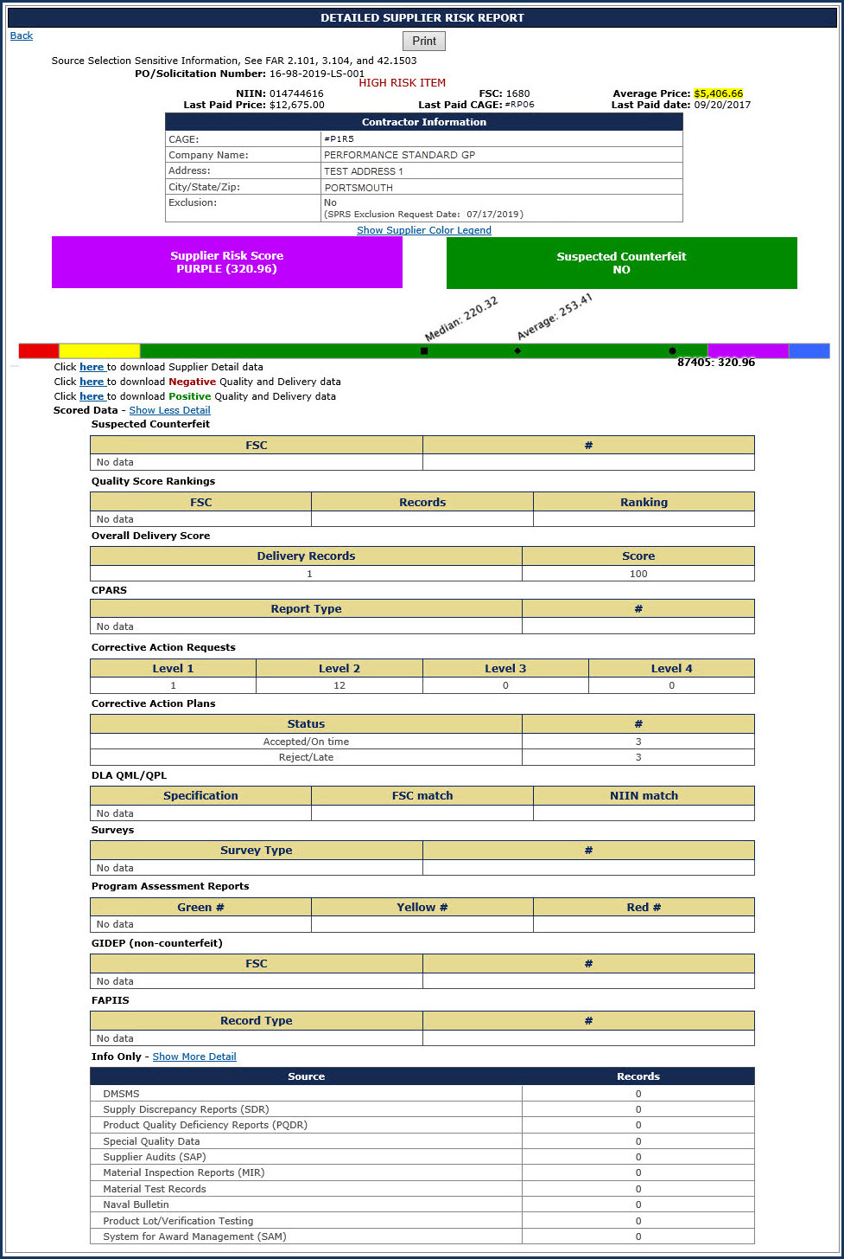
Risk Analysis
Supplier Risk Score 2
  Click any linked Supplier Risk Score on
  the Summary Risk Analysis Report to
  display the Detailed Supplier Risk Report
  Scored Data are Factors that go into the
  numerical score
  If records are > 0, the Factor becomes a link to
  display additional detail
  Info Only is data of interest but not scored
  Detail is available if records are > 0
  Click the Show More Detail link for
  Scored Data
  *NOTE: The Supplier Score shown when
  performing a procurement Risk Analysis also
  considers if the vendor is on DLA’s Qualified
  Manufacturer/Producer List, so it may be
  different than the one displayed in the
  standalone Supplier Risk report

Slide 17
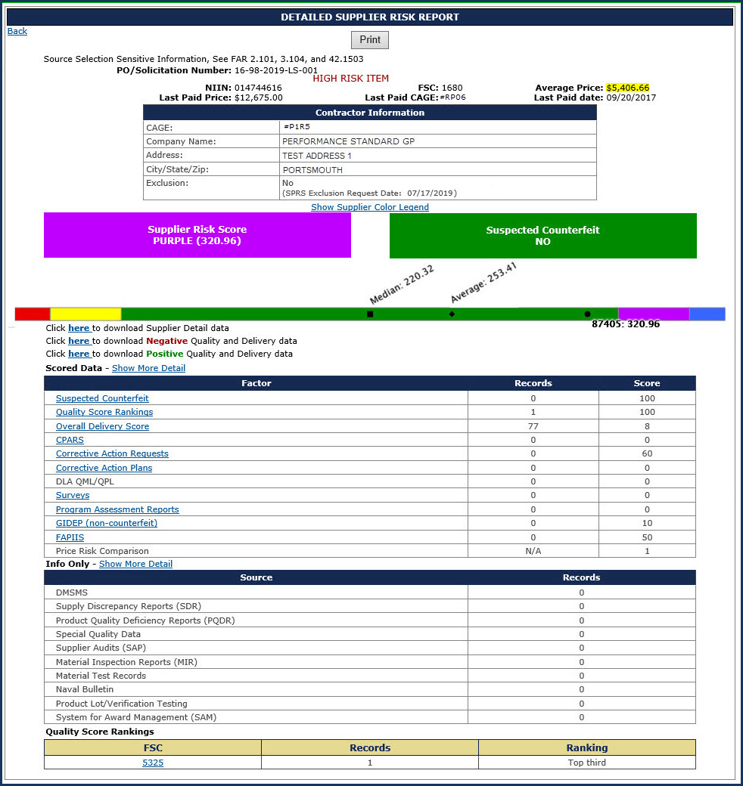
Risk Analysis
Supplier Risk Score 3 2
  Click any linked Supplier Risk Score on
  the Summary Risk Analysis Report to
  display the Detailed Supplier Risk Report
  Scored Data are Factors that go into the
  numerical score
  If records are > 0, the Factor becomes a link to
  display additional detail
  Info Only is data of interest but not scored
  Detail is available if records are > 0
  Click the Show More Detail link for
  Scored Data
  Click the Quality Score Rankings link under
  Scored Data
  Click any FSC to see Detail Report for that FSC
  *NOTE: The Supplier Score shown when
  performing a procurement Risk Analysis also
  considers if the vendor is on DLA’s Qualified
  Manufacturer/Producer List, so it may be
  different than the one displayed in the
  standalone Supplier Risk report

Slide 18
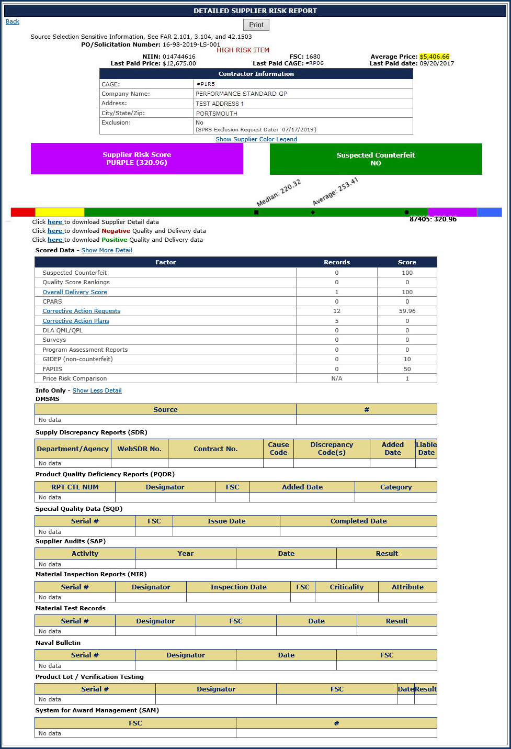
Risk Analysis
Supplier Risk Score 4
  Click any linked Supplier Risk Score on
  the Summary Risk Analysis Report to
  display the Detailed Supplier Risk Report
  Scored Data are Factors that go into the
  numerical score
  If records are > 0, the Factor becomes a link to
  display additional detail
  Info Only is data of interest but not scored
  Detail is available if records are > 0
  Click the Show More Detail link for
  Scored Data
  Click the Quality Score Rankings link under
  Scored Data
  Click any FSC to see Detail Report for that FSC
Click the Show More Detail link for Info Only
  *NOTE: The Supplier Score shown when
  performing a procurement Risk Analysis also
  considers if the vendor is on DLA’s Qualified
  Manufacturer/Producer List, so it may be
  different than the one displayed in the
  standalone Supplier Risk report

Slide 19
Risk Analysis – Save Solicitation
  Click the Save Solicitation button

Slide 20
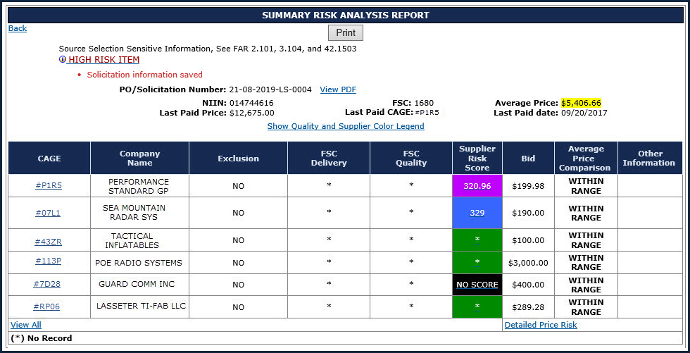
Risk Analysis – Save Solicitation 2
  Solicitation Saved notification
  Click View PDF link to view saved solicitation

Slide 21
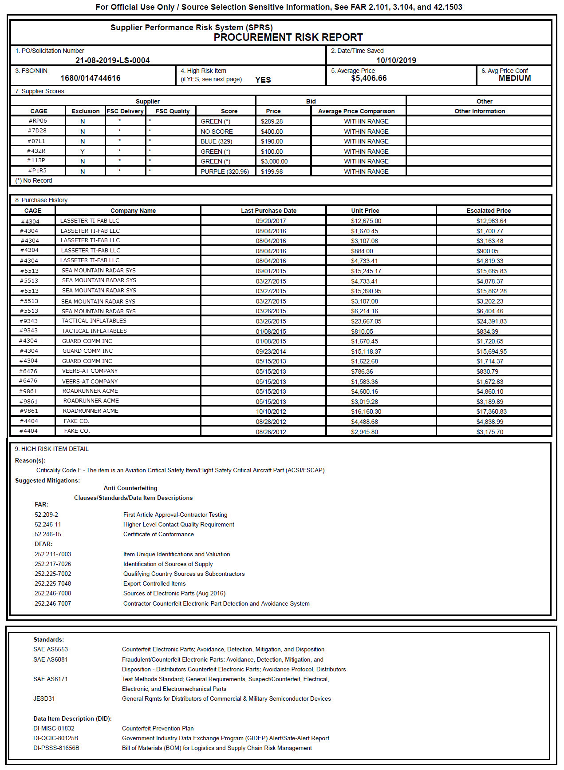
Risk Analysis
Save Solicitation
  View Saved Solicitation

Slide 22
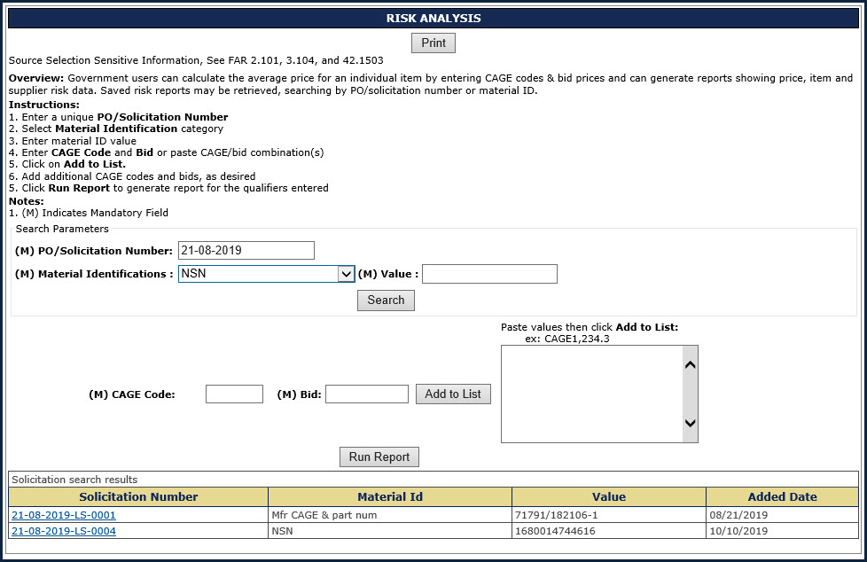
Risk Analysis – Save Solicitation 3
Retrieving Previously Saved Risk Analysis
Enter existing
PO/Solicitation number
  If a matching Risk Analysis
  record is found, click
  solicitation number to display
  printable/savable PDF

Slide 23
Supplier Risk Report
Standalone way to see detailed Supplier Risk
The Supplier Score shown in the
Standalone Supplier Risk Report does not
consider if the vendor is on DLA’s Qualified
Manufacturer/Producer List, so it may be
different than the one displayed when
performing a procurement
Risk Analysis report
Information displayed is
the same as shown in the
Detailed Summary Risk
Analysis Report

Slide 24
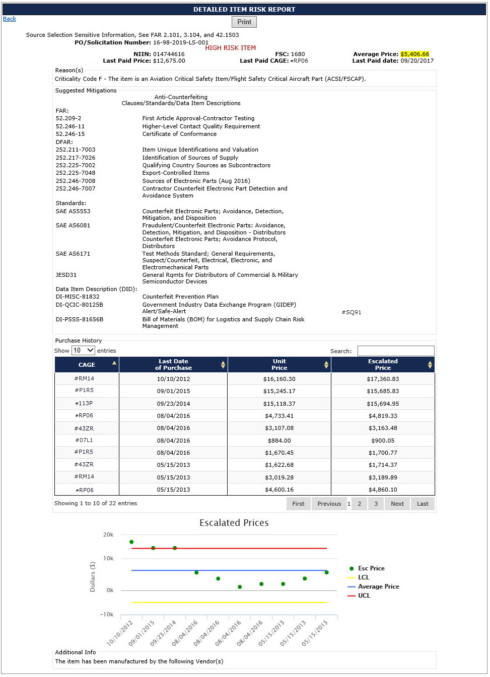
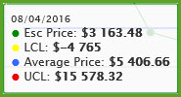
Item Risk Report Detail
Detailed Item Risk Report displays:
  Agency-supplied risk detail
  One or more reasons for the item to be considered High Risk
  Suggested mitigation strategies based on agency policies
Agency/service detail and mitigations
Purchase history table and chart
(as seen in Detailed Risk Analysis)
Hover over points for Detail

Slide 25
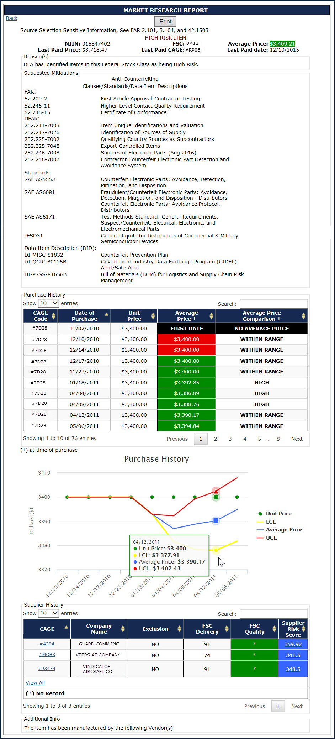
Market Research Report Detail
Item Risk Data
Price Risk assessment
of previous buys
(did we pay too much back then?)
Plot of previous buys
Supplier Risk scores for
previous vendors
(Who has sold us this
item before?)

Slide 26
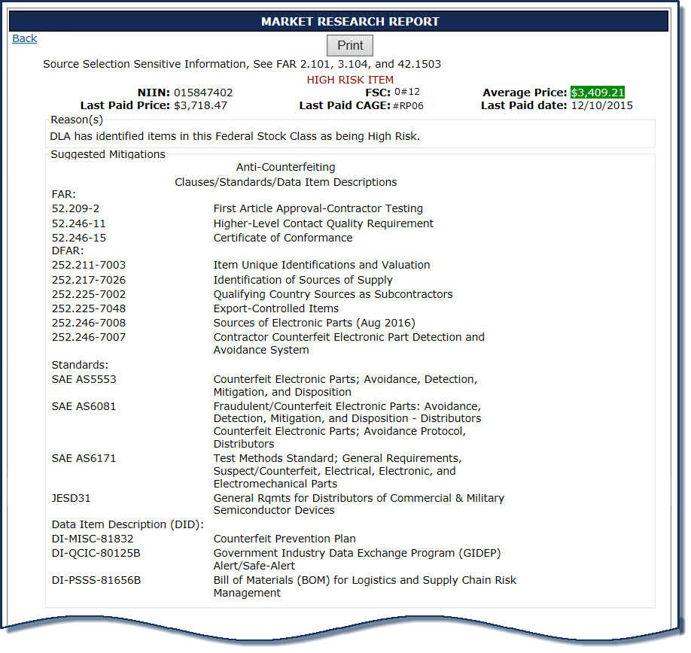
Market Research Report Detail Top
Item Risk Data

Slide 27
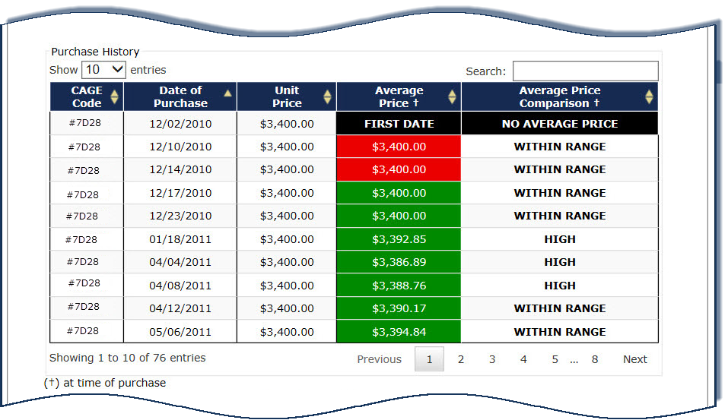
Market Research Report Detail Middle
Price Risk assessment
of previous buys
(did we pay too much back then?)

Slide 28
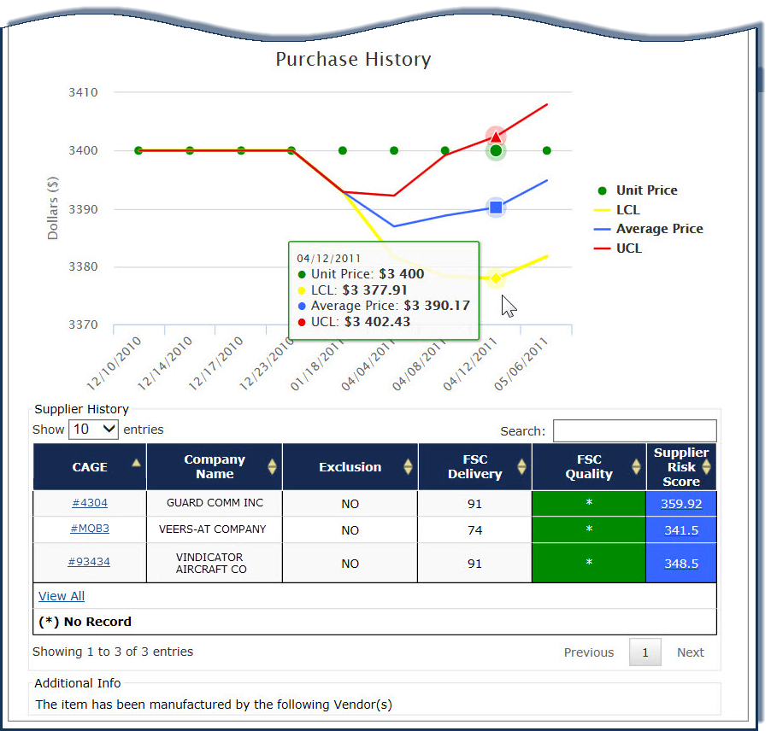
Market Research Report Detail Bottom
Plot of previous buys
Supplier Risk scores for
previous vendors
(Who has sold us this
item before?)

Slide 29
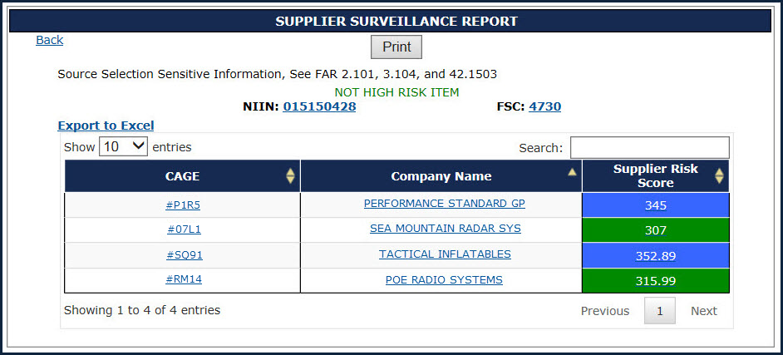
Supplier Surveillance Report by Material ID
If search by Material ID is chosen:
Click on either the linked NIIN or FSC to display the Detailed Item Risk Report

Slide 30
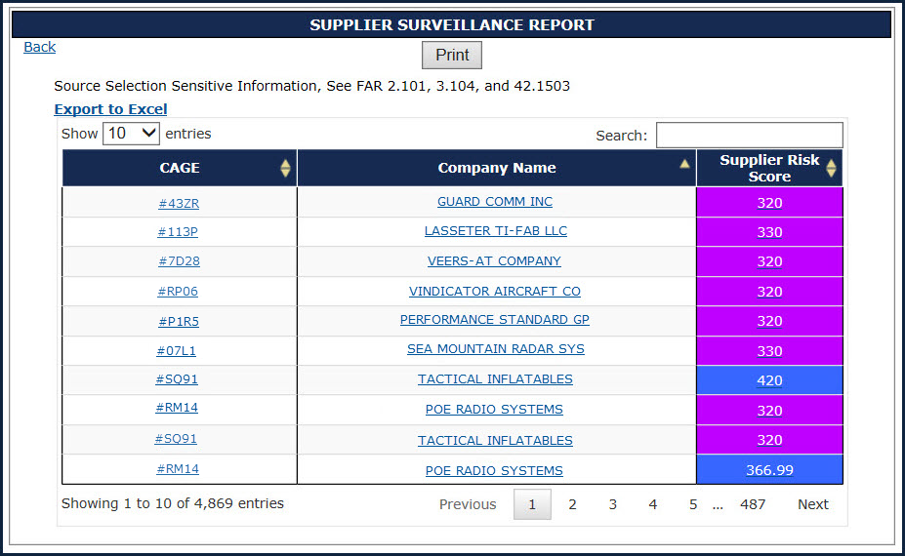
Supplier Surveillance Report by Quality Score Color
If search by Quality Score Color or Colors is chosen:
On either of these screens
click any CAGE, Company Name,
or Supplier Risk Score to display
the Supplier Risk Report
for your selection

Slide 31
SPRS Contact Information
SPRS Website:
https://www.sprs.csd.disa.mil
NSLC Help Desk (Mon-Fri 6:30am- 6:00pm ET) :
    (207) 438-1690
    DSN 684-1690
    NSLC Help Desk Email: webptsmh@navy.mil

Slide 32
Thank You
Thank
you
for participating in the
SPRS 201 Class

